Slide 1

MovieRec: Database-Driven Movie Recommendation System
A comprehensive MySQL database project designed to power intelligent movie recommendations through user interactions, ratings, and collaborative filtering.
Team : BingeBuddy
Team Members :
Daksh Shah (24BCP240)
Mahir Shah (24BCP261)

Slide 2
Project Overview & Objectives
Core Mission
Design and implement a robust, scalable MySQL database (movie_rec_db) to serve as the central repository for users, movies, and their interactions. The system supports user authentication, movie browsing, rating submissions, and personalized recommendations.
Requirements Analysis: Data & Functionality
Data Entities
Core Operations
Recommendation Types
User credentials & timestamps
User authentication
Popularity-based
Movie details & metadata
Movie search & filtering
Content-based
Actors & directors info
Rating management
Collaborative filtering
Genres taxonomy
Watchlist creation
Personalized
Ratings & reviews
Recommendation generation
Watchlists
Admin functions

Slide 3





Conceptual Design: Entity-Relationship Model
The database comprises 12 tables organized around core entities and junction tables for many-to-many relationships. Users create ratings and reviews for movies. Movies are associated with multiple genres, actors, and directors through junction tables. Watchlists allow users to organize movies for future viewing.
Core Entities
Relationships
Users, Movies, Genres, Actors, Directors, Reviews, Watchlists
1
2
Ratings (user-movie), Movie-Genres, Movie-Actors, Movie-Directors
Design Compliance
Junction Tables
4
3
12 tables exceed requirement (≥10 relations for N=2)
Ratings, Movie_Genres, Movie_Actors, Movie_Directors, Watchlist_Items

Slide 4
Relational Schema & SQL Implementation
The schema enforces data integrity through PRIMARY KEYs, FOREIGN KEYs with CASCADE deletion, and UNIQUE constraints. Key tables include users (with unique username/email), movies (core metadata), ratings (composite key on user_id, movie_id), and junction tables managing many-to-many relationships.
Users Table
Movies Table
user_id, username (UNIQUE), email (UNIQUE), password_hash, created_at
movie_id, title, release_year, synopsis, duration_min
Ratings Table
Junction Tables
Composite PK (user_id, movie_id), rating (1-5), created_at, FK constraints
Movie_Genres, Movie_Actors (with role_name), Movie_Directors, Watchlist_Items

Slide 5
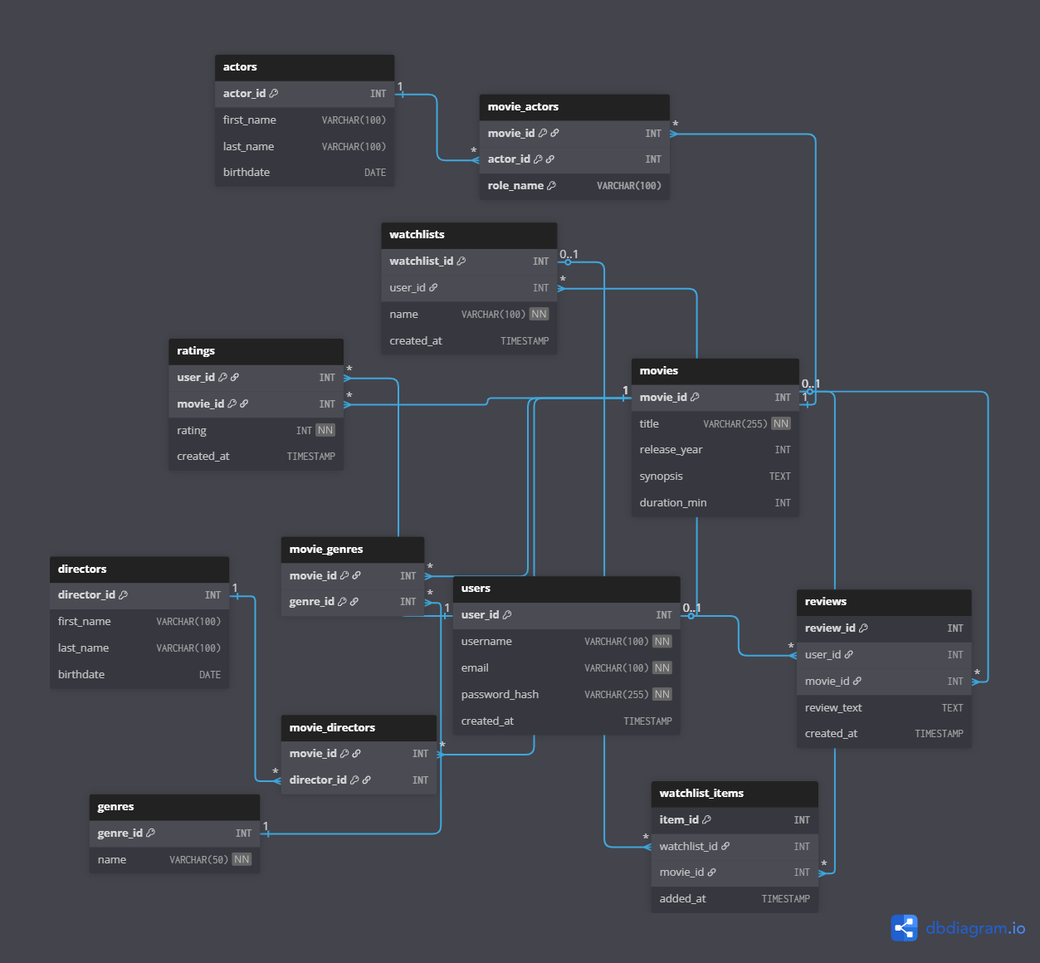

Slide 6
Data Population & Scale
A Python script (data_generator.py) using the Faker library populated the database with 26,120 realistic records, significantly exceeding the project requirement (≥6,000 records for N=2). This volume enables comprehensive testing of query performance and recommendation algorithms.
200
1K
10K
26.1K
Users
Movies
Ratings
Total Records
Entity
Count
Entity
Count
Users
200
Genres
20
Movies
1,000
Actors
500
Ratings
10,000
Directors
100
Reviews
500
Watchlists
300

Slide 7
Core Query Examples: Atomic Rating & Search
Query 1 - Atomic Rating Update: Uses INSERT ... ON DUPLICATE KEY UPDATE to atomically insert new ratings or update existing ones, ensuring data integrity without separate check-then-insert transactions.
Query 2 - Dynamic Movie Search: Retrieves movies with dynamic JOIN and WHERE clauses based on user input for search terms and genre filters, returning up to 50 results with calculated average ratings.
INSERT INTO ratings (user_id, movie_id, rating)
VALUES (%s, %s, %s)
ON DUPLICATE KEY UPDATE rating = VALUES(rating);
SELECT m.movie_id, m.title, m.release_year,
COALESCE(AVG(r.rating), 0) AS average_rating
FROM movies m LEFT JOIN ratings r ON m.movie_id = r.movie_id
JOIN movie_genres mg ON m.movie_id = mg.movie_id
WHERE mg.genre_id = %s AND m.title LIKE %s
GROUP BY m.movie_id, m.title, m.release_year
ORDER BY m.title ASC LIMIT 50;

Slide 8
Advanced Queries: Recommendation Engines
Popularity-Based: Calculates weighted ratings (IMDB formula) for all movies, filtering those with insufficient ratings, returning top 10 most popular films.
Content-Based: Uses CTEs to identify user's favorite genres from highly-rated movies, then recommends similar unwatched movies based on genre matches and average ratings.
Collaborative Filtering: Identifies "similar users" who rated the same movies highly, then recommends movies those similar users liked but the target user hasn't rated.
01
02
03
Weighted Rating Formula
CTE-Based Content Logic
Multi-Level Collaborative Logic
Combines average rating with global average, weighted by number of ratings to favor movies with more user engagement.
Common Table Expressions separate complex logic: identify favorite genres, exclude rated movies, match and rank by genre overlap.
Three CTEs: target user's high ratings, similar users (≥3 shared likes), recommended movies from similar users, ranked by popularity.

Slide 9
Testing & Validation
Data Integrity Testing
Data Population Validation
UNIQUE constraints prevented duplicate usernames. FOREIGN KEY constraints rejected invalid references. INSERT ... ON DUPLICATE KEY UPDATE confirmed atomic rating updates.
Python script executed successfully. SELECT COUNT(*) queries verified all 12 tables contained correct record counts totaling 26,120 records, exceeding requirements.
Query Correctness Testing
Application-Level Testing
Recommendation queries executed and analyzed for logical correctness. Content-based results shared genres; popularity results had high ratings. Dynamic search confirmed proper WHERE and JOIN clause construction.
All features (Login, Register, Rate, Watchlist) tested systematically. MySQL query logs monitored to confirm correct data flow from application to database and back to frontend.

Slide 10


Conclusion & Future Enhancements
MovieRec successfully demonstrates comprehensive database design, implementation, and querying for a movie recommendation system. The 12-table normalized schema prevents redundancy and ensures data integrity. Complex recommendation engines leverage CTEs for logical separation of multi-step logic. Key technical achievements include atomic rating updates and dynamic query construction.
Current Strengths
Normalized schema, referential integrity, atomic operations, three recommendation algorithms, 26K+ records for testing.
Future Optimizations
Future work could involve database-level optimizations, such as adding indexes to frequently queried columns (movies.title, ratings.movie_id) to improve the performance of searches and joins.

